Slide 1
Decoding Cognitive States for Therapy Applications

Slide 2
Why is it important?
“The National Institute of Mental Health (NIMH) conservatively estimates the total costs associated with serious mental illness, those disorders that are severely debilitating and affect about 6 percent of the adult population, to be in excess of $300 billion per year”
Insel TR. Assessing the economic cost of serious mental illness. Am J Psychiatry. 2008 Jun; 165(6):663-5.

Slide 3
Why is it important?
Despite many recent advances in neuroscience, we still do not have a sufficient understanding of the brain to directly address these illnesses
However, novel therapies that integrate psychology and neuroscience have begun to show impressive results

Slide 4
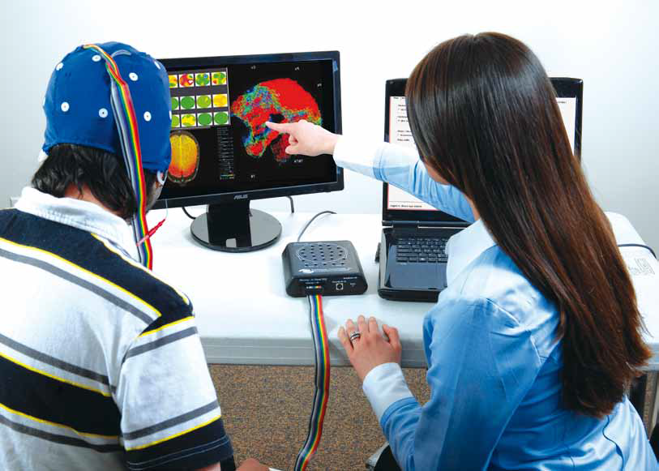
ADHD real-time neuro-feedback therapy
Individuals learn to produce and maintain a pattern of EEG activity that is consistent with a focused and attentive state
Recent studies have yielded exceptionally positive results

Slide 5
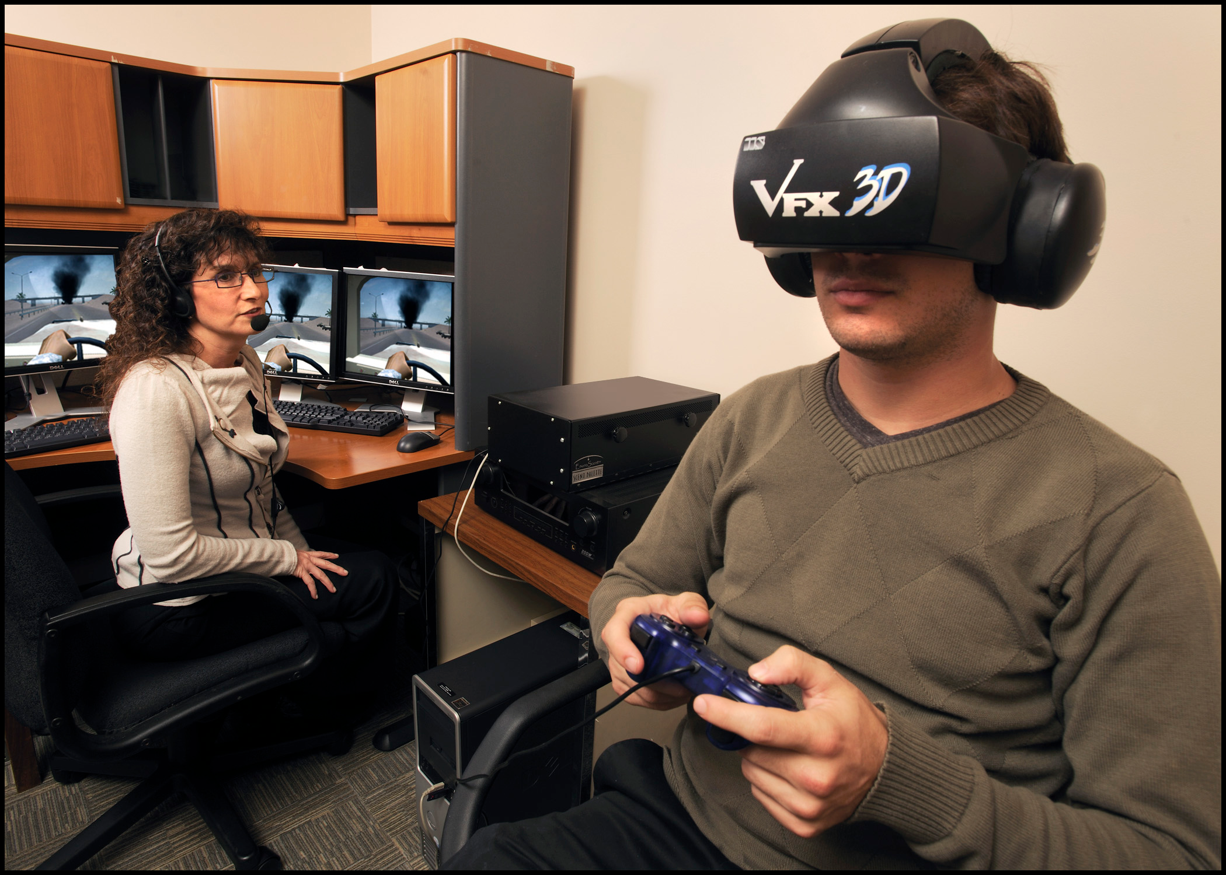
PTSD Exposure Therapy
Exposes patients to triggering stimuli in safe environment to recondition response
Therapist must constantly inquire as to the subjects level of discomfort
Neuro-feedback could be provided directly to the subject to ed to augment therapy as well as provide therapist useful information on the state of the subject and the progress of the therapy

Slide 6
At the same time, great strides have been made in neuroimaging techniques for decoding cognitive state:
[Interesting examples]
We want to leverage these recent advances to create a general framework for improving innovative therapies.

Slide 7
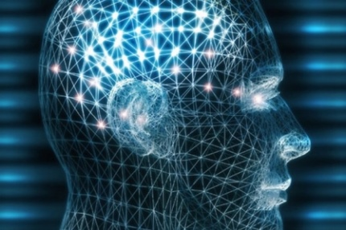
Decoding cognitive states
What is a cognitive state?
Patterns of neural activation associated with a particular behavior or perception
Sensory: viewing a particular type of object
Behavioral: performing a particular task
Internal: feeling discomfort
Cognitive states can overlap and are non-orthogonal

Slide 8
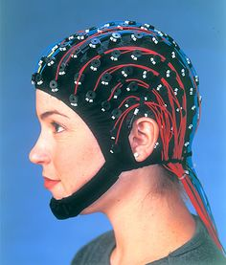
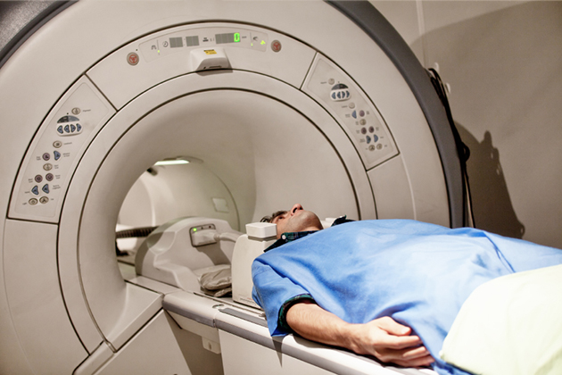
Decoding cognitive states
What is decoding?
Determining the current cognitive state from some measure of neural activation
functional magnetic resonance imaging (fMRI)
electro-encephalography (EEG)

Slide 9
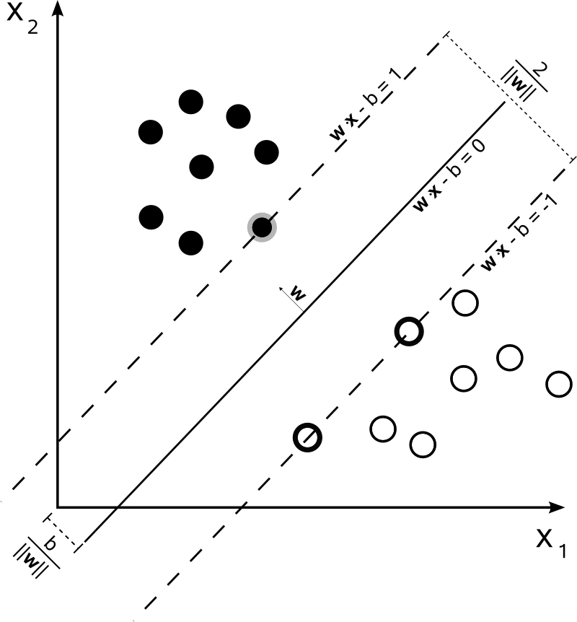
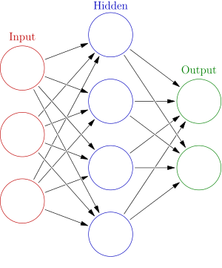
Decoding cognitive states
Generally try to discriminate non-overlapping sets of cognitive states
Machine learning classifiers are usually applied to solve this problem
support vector machine (SVM)
neural network (NN)

Slide 10
fMRI or EEG?
EEG is considerably cheaper than fMRI which makes it attractive for therapy applications
Want to be able to leverage more data and translate to neuroscience
fMRI has larger existing public datasets that can be reasonably combined
The higher spatial resolution of fMRI and the difficulty of the inverse problem in EEG means registering datasets together is much easier in fMRI
Many existing neuroscience meta-studies that already leverage this advantage (refs)
Can eventually translate models to EEG using simultaneous fMRI/EEG recordings (ref)

Slide 11
Constraints
Subject cannot move
Focus on virtual reality training/therapy
Scanning is expensive
Want to minimize time in scanner
Curse of dimensionality
Dimensionality of data much larger than the number of samples collected in a single session

Slide 12
Objectives
Build realistic virtual environment
Virtual reality therapies are uniquely well suited to fMRI neuro-feedback
We must ensure that our decoding methods function in such an environment

Slide 13
Objectives
Build realistic virtual environment
Maximize decoding accuracy
If therapeutic decisions are going to rely on the results we must ensure they are as accurate as possible for the safety of the patient
Inaccurate neuro-feedback can do more harm than good if the patient incorrectly associates with the wrong states

Slide 14
Objectives
Build realistic virtual environment
Maximize decoding accuracy
Run in real-time
To be effective in neuro-feedback therapies we must be able to decode states in real-time

Slide 15
Objectives
Build realistic virtual environment
Maximize decoding accuracy
Run in real-time
Visualize models in the brain
Valuable for exploratory analysis and generating neuroscience hypotheses

Slide 16
Objectives
Build realistic virtual environment
Maximize decoding accuracy
Run in real-time
Visualize models in the brain

Slide 17
Virtual Environments and Stimuli for fMRI
Build virtual environment and stimuli for testing
Intended to be visually similar to environments used in current virtual reality PTSD exposure therapies
Build stimuli within this virtual environment to test decoding methods
Develop video processing techniques to minimize low level contrast variations in real-time

Slide 18
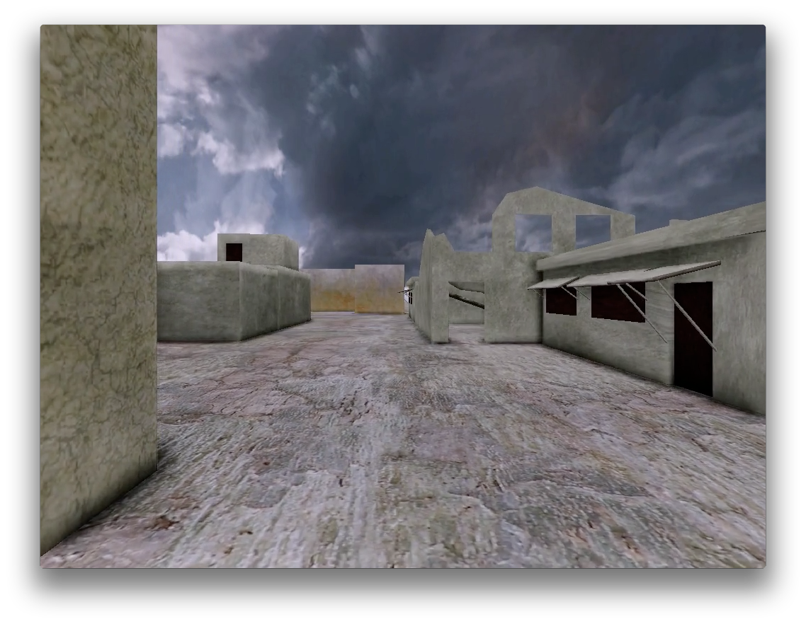
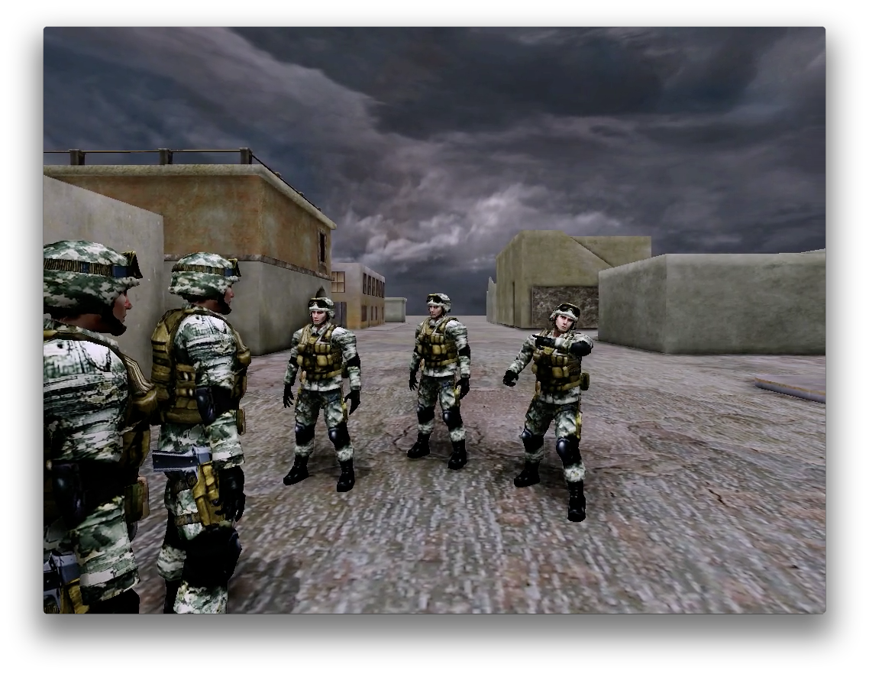
Virtual Environment V.1
Decoding number of characters

Slide 19
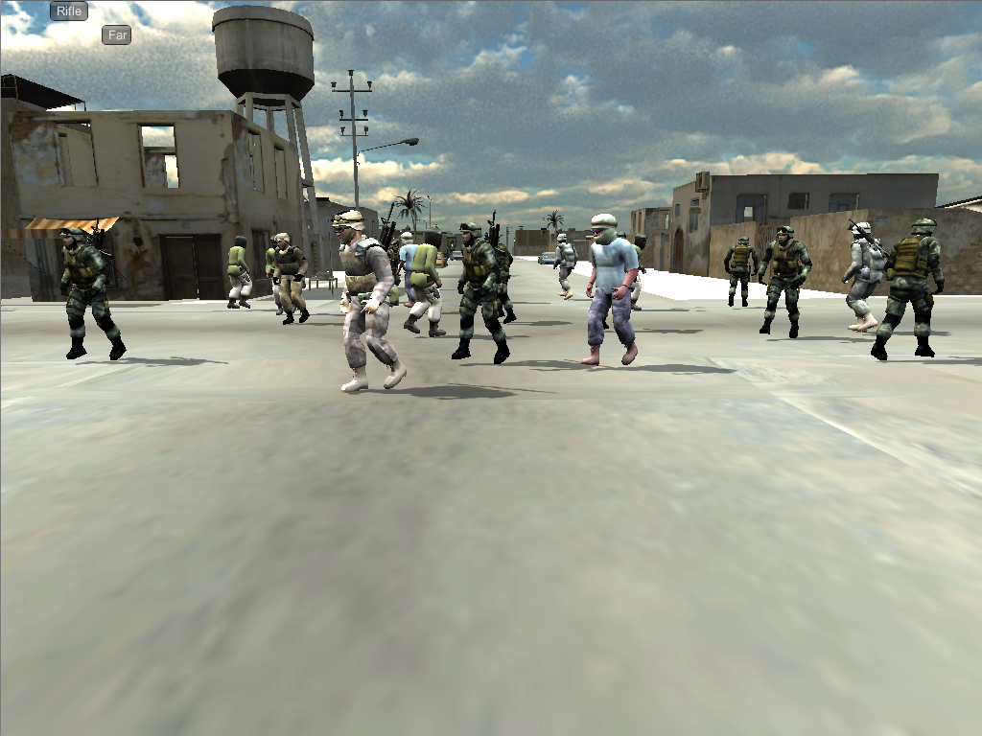
Virtual Environment V.2
Decoding performance at weapon detection task

Slide 20
Real-time low-level contrast adjustment

Slide 21
Objectives
Build realistic virtual environment
Maximize decoding accuracy
Run in real-time
Visualize models in the brain

Slide 22
Decoding Background
Many examples of cognitive states
Object categories
What a person is saying and who is saying it
Telling the truth or lying
Planning vs executing
Focus on proving localized significant effect
No attempt to maximize decoding accuracy
Limited use of advanced machine learning algorithms
Highly controlled and simple stimuli
Unclear if results translate to more realistic stimuli

Slide 23
Establish baseline decoding accuracy
First we established baseline performance decoding the number of visible characters in our virtual environment for four popular machine learning algorithms
Well above chance but accuracy needed to be improved for practical application

Slide 24
Smoothing and Sampling
Data is ill-posed for machine learning with many more input dimensions than samples
We want to reduce redundant dimensionality of data to alleviate this issue
Data agnostic approaches such as PCA or ICA can be effective but we can do better by leveraging knowledge of the the source of the fMRI signal and the structure of the brain

Slide 25
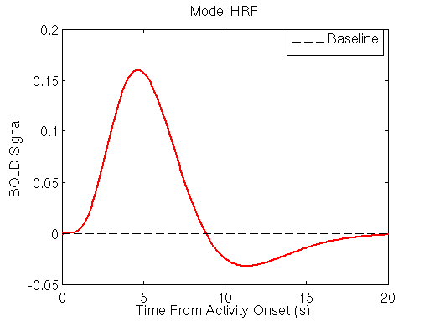
Temporal Smoothing
fMRI does not measure neural activity directly, but rather the change in blood-oxygen concentration correlated with neural activity
This change in blood-oxygen concentration is not instantaneous and is modeled using a hemodynamic response function (HRF)
Wiener filtering using a model HRF [ref] improved decoding accuracy over simple time shifting by ~5% on average across sessions

Slide 26
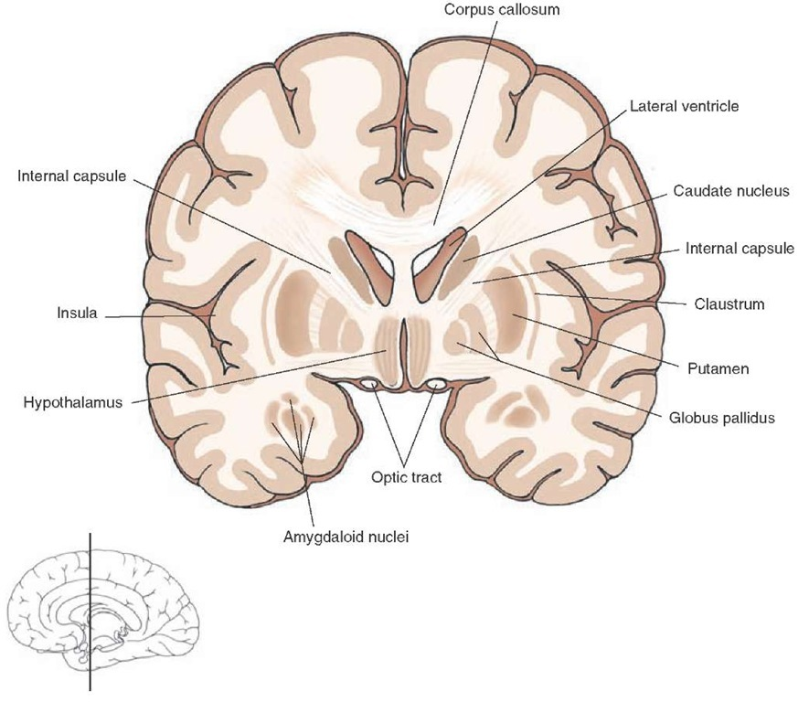
Smoothing and Sampling
We record data from the entire brain including white matter, ventricles, and even extra-cortical tissue and blood vessels.
Data recorded outside of the gray matter can be considered noise
We can reduce the dimensionality immensely by extracting the gray matter voxels
Furthermore, by extracting the cortical surfaces we can prevent smoothing across sulci

Slide 27
Smoothing and Sampling

Slide 28
Temporal Filtering
There is temporal structure in cognitive state space dependent on the stimuli
We found that we could improve decoding by filtering in cognitive state space after classification

Slide 29
Objectives
Build realistic virtual environment
Maximize decoding accuracy
Run in real-time
Visualize models in the brain

Slide 30
Real-time Background
Many techniques have been developed for real-time fMRI
However, there has so far been very little overlap with decoding cognitive states
Best example is online training of an SVM at a very simple decoding task
No online registration or motion correction

Slide 31
Run in real-time
Perform model training off-line
Requires on-line registration to model
Most machine learning algorithms are already fast enough at decoding
Temporal filtering will introduce output delay
Need to tune accuracy tradeoff with acceptable delay

Slide 32
Robust registration pipeline
test
Functional scan session
Structural scan session
(offline)
Functional scan sessions
(online)
Structural
Skull-strip
normalize
Inplane
scan
Robust
register
Functional scans
Motion
and
slice-timing
Functional
Skull-strip
normalize
Surface
volumes
Spherical
Template
registration
Boundary
Based
registration
Smoothing
And
Surface
projection

Slide 33
Objectives
Build realistic virtual environment
Maximize decoding accuracy
Run in real-time
Visualize models in the brain

Slide 34
Mapping Background
GLM
Simple yet powerful for showing significant localized correlations
However, is linear and univariate and therefore cannot capture complicated patterns of activation
Searchlight
Perform machine learning on small kernels of voxels
Can capture non-linear effects but still cannot account for large spatial patterns
Absolute Discriminate Map
Visualize weights of model directly
Resulting maps can be highly dependent on regularization of the model
Easy to visualize when model is linear and model dimensionality is the same as input dimensionality
How can we generalize to non-linear and complex models?

Slide 35
Visualize models in the brain
Want to be able to visualize trained models in the brain
Useful for debugging and formulating neuroscience hypotheses
Multivariate and non-linear models can be hard to visualize in only three dimensions

Slide 36
Mapping
Sensitivity Analysis
Differentiate decoder outputs with respect to inputs
Evaluate derivative on every training example
Calculate RMS value across examples
Left with a map the size of the input dimension for each output
Can examine individually or aggregate across outputs
For linear SVM simplifies to absolute discriminate map

Slide 37
Mapping

Slide 38
Thresholding
Reasonable thresholding of the map can be achieved via recursive feature elimination
Threshold selected when classifier performance not significantly different from chance

Slide 39
Future Work
Build realistic virtual environment
Build third stimulus that allows for freeform subject planning and state transitions
Maximize decoding accuracy
Hidden Markov Model approach to temporal filtering
Run in real-time
Integrate registration and decoding pipelines and return real-time state transition feedback
Visualize Models
Visualize trained model including hidden Markov model

Slide 40
Freeform Stimulus

Slide 41
Hidden Markov Model
Current temporal filters rely on knowledge of block structure of stimuli
In a practical application, the block structure would be unknown
Treat cognitive state transitions for a particular task as a hidden Markov model
Use a machine learning algorithm (neural network for example) to estimate prior probability of a state given the signal at a particular time step
Calculate most likely sequence of states over a fixed number of observations based on probability output
The transition probability matrix can be easily estimated from the group data since no registration is required

Slide 42
Real-time feedback

Slide 43
Visualizing decoder with hidden markov model

Slide 44
Questions?

